Slide 1
Report Back of
Pilot Project Experience
Dr Regina CHING
Assistant Director(Health Promotion)
18 May 2012

Slide 2
Overview
Objectives
Components
Workforce Health Status
Project Evaluation
Success Factors
Way Forward

Slide 3
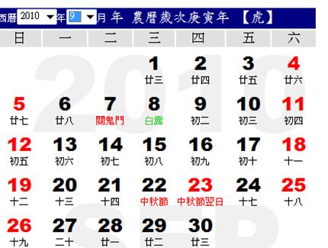
Objectives
To develop a model of Workforce Health Promotion (WHP) that will increase health awareness and literacy of the workforce
To assess the feasibility, acceptability, effectiveness and efficiency of the model of WHP
December 2011
September 2010
15 months

Slide 4
Components
Recruitment
Setting up a Wellness Committee
Conducting needs assessment
Health promotion interventions
Evaluation
Healthy eating
Smoking cessation
Physical activity

Slide 5
Workforce Health Status
Higher prevalence of overweight (19.4%) and obesity (27.3%) among the compared with the general population.
Most staff (95.9%) had inadequate intake of fruit and vegetables
Current smokers accounted for 11.8% of all “Health Day” participants.
Most participants (76.4%) reported low level of physical activity.
 | Workforce | General population
Overweight* | 19.4% | 18.7%
Obesity* | 27.3% | 21.7%
Inadequate fruit & vegetable intake | 95.9% | 80.9%
Physical inactivity⁺ | 76.4% | 64.2%
*Weight status by WHO classification (Asian standard)
+ Not meeting WHO’s recommended level

Slide 6
Project Evaluation
Information for Evaluation
Post-workshop survey
Structured interview with WC members

Slide 7
Employee perspective
Participants’ satisfaction was generally high (99.8%) across the spectrum of health promotion interventions
Over 96% would recommend these workshops to other colleagues.
The majority of respondents (over 98%) agreed or strongly agreed that the subject matter helped them in the practice of healthy lifestyle.

Slide 8
Wellness Committee perspective
(a) Health promotion interventions and information
Health promotion activities and health information
informative
useful
Instructors
professional
knowledgeable
Souvenirs
attractive
easy to use
Workshop duration
optimal
Disseminating health information beyond the confines of the workplace to reach a wider audience and community
Generated synergistic effect with other health promotion initiatives
Community
Workplace
Family
Individual

Slide 9
Wellness Committee perspective
(b) Environmental changes
Some organisational changes related to healthy lifestyles were observed and reported by WCs
Some examples were
providing fruit to their staff at intervals of once or twice a month
providing low-fat milk and less sugary drinks in the workplace as healthier options
sponsoring staff to participate in physical activities
offering financial incentive to encourage staff to engage in more walking to and from office

Slide 10
Wellness Committee perspective
(c) Resource implications
Acceptable and affordable in terms of time and human resource requirement
All WCs remarked that they looked forward to participating in future projects even though some parts of project might be fee-charging.
Little difficulty in funding workshops of similar nature
Lacked the professional expertise in determining the credibility of the persons or organisations commissioned to run these workshops

Slide 11
Success factors
Active leadership and organisation-al commitment
Corporate-centric approach
Case management approach
Needs assessment and evaluation
Close collaboration with other stakeholders
Taking company size and structure into account
Synergistic effect on overall population health improvement

Slide 12
Dispelling Myths about WHP
WHP programme costs a lot of money and time
Running a WHP programme requires a lot of space in the company
WHP programme must be run by health experts
WHP programme is about exercise classes and health talks

Slide 13
Way Forward
In business terms-
Increasing productivity
Increasing job satisfaction
Improving staff’s morale
Retaining staff
Decreasing absenteeism
Reducing workplace injuries
Creating a positive corporate image
Improved Employee Health

Slide 14
WHP reduce health care costs, increase productivity and reduce absenteeism
Workers’ comp./ disability management claims costs
Health costs
Absenteeism
Source: Chapman, L. (2003). Meta-evaluation of Worksite Health Promotion Economic Return Studies. Art of Health Promotion Newsletter, 6(6).
Notes:
Many review articles show that efforts within the personal lifestyle behaviour change approach can save employers money, largely by decreasing employee medical costs and absenteeism.
Depending on how you measure cost benefit, results show cost benefit ratios of between 1:3 and 1:4.

Slide 15
Healthy Life
Healthy Workplace
Guaranteed Results
JOIN THE NEXT PHASE OF THE PROJECT
MAKE THE DIFFERENCE!
http://www.cheu.gov.hk/healthatwork/

