Slide 1
Introduction of the next phase of
the Health@work.hk Project
Dr Alex FU
Senior Medical and Health Officer (Health Promotion)
18 May 2012

Slide 2
Workplace Health Promotion
“Combined efforts of employers, employees and society to improve the health and well-being of people at work”
Luxemburg Declaration,1997
Healthy employees
Productive employees
Successful businesses
Health economy
Sustainable development
WHP is a good investment!
Notes:
Luxemburg Declaration on Workplace Health Promotion in the EU
1997年歐盟的工作場所健康促進盧森堡宣言
工作場所健康促進有賴雇主、勞工、社會三方面共同努力
A workplace health promotion programme can benefit your organisation.

Slide 3
You can influence the health of your workforce
Health of the workforce impacts on your business
A little effort does go a long way

Slide 4
Critical Success Factors
Active leadership and organisational commitment
Corporate-centric approach
Case management approach
Needs assessment and evaluation
Close collaboration with other stakeholders
Taking company size and structure into account
Synergistic effect on overall population health improvement

Slide 5
Main Focus
Suitability
Applicability
Sustainability
Partnerships

Slide 6
3 types of interventions
Organisation polices
Supportive environmental measures
Lifestyle and personal health skills

Slide 7
Main areas
Healthy eating
Physical activity
Smoking cessation
Alcohol use
Baby friendly workplace

Slide 8
Who
Companies registered in Hong Kong and have substantive business operation
Undertakes to promote workforce health and wellbeing

Slide 9
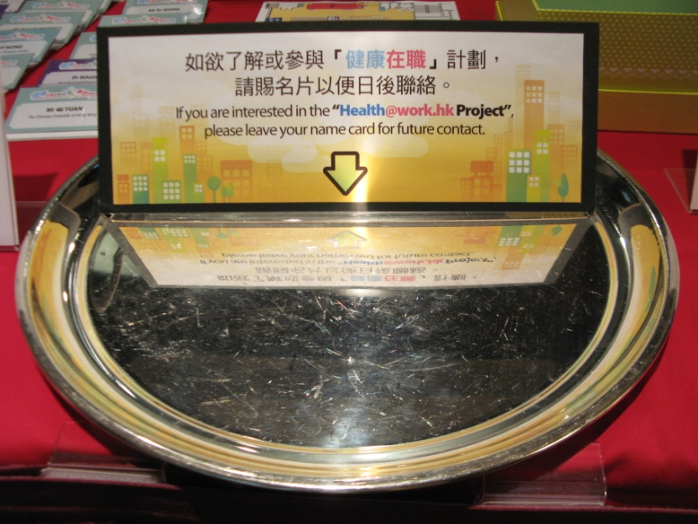
How

Slide 10
When
NOW

Slide 11
What will happen……

Slide 12
Set up wellness committee
Corporate questionnaire and site visit
Health Day
Recommend and conduct health promotion events
Project evaluation
Company
DH
Service providers
Other health promotion partners

Slide 13
How much
Service Providers
Company
＄
Health Promotion
Activities
＄

Slide 14
http://www.cheu.gov.hk/healthatwork
Email: health_cheuweb@dh.gov.hk

Slide 15
End of Presentation Thank you

