Slide 1
Health@work.hk Pilot Project 健 康 在 職 先 導 計 劃
Presented by: Stephen Tao Date: 18 May 2012
text

Slide 2
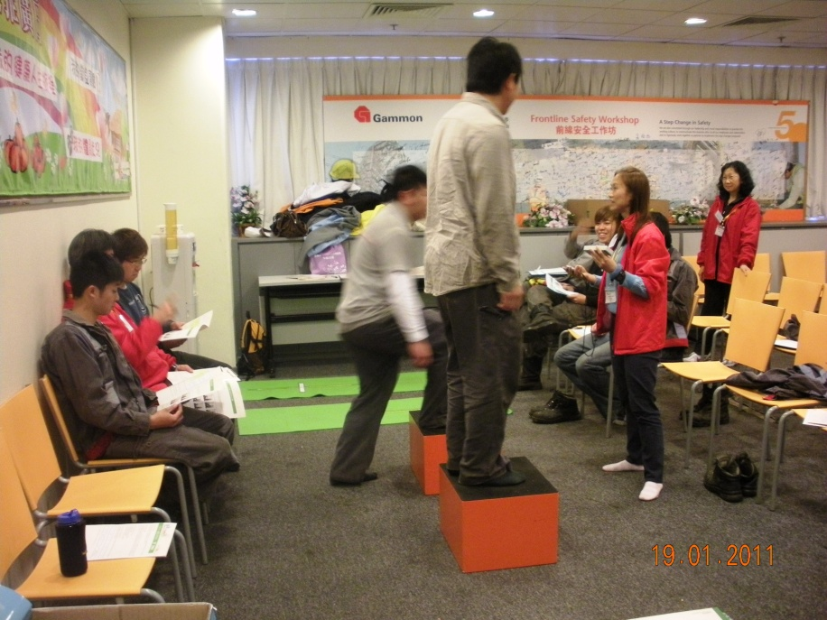
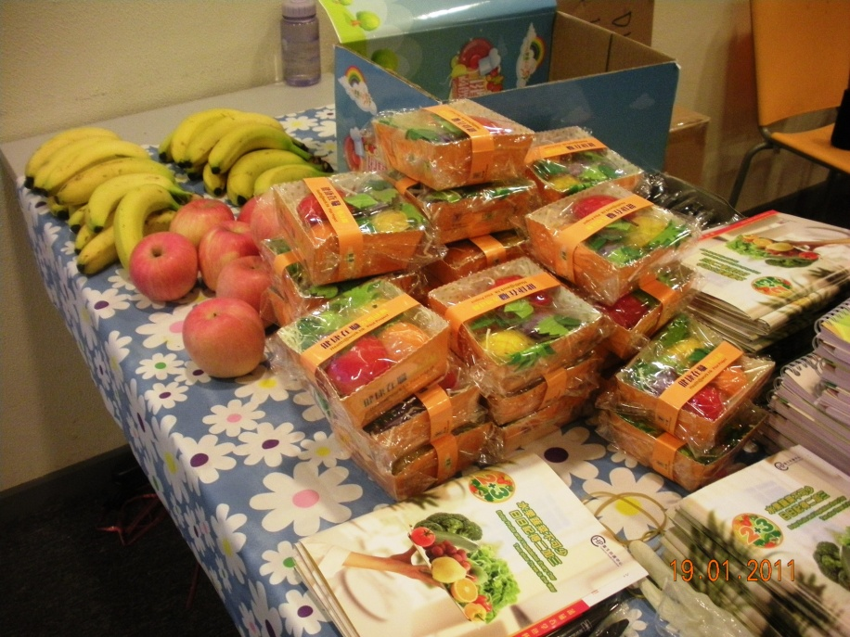
H&S Events
21 February 2011
Health@work.hk Pilot Project
Update
The 1st activity was “Health Day”.
It was held on 19 & 20 January 2011 respectively.
A total of 143 employees joined the Health Day.
Central Health Education Unit provided us with a report briefing on 17 March 2011.

Slide 3
H&S Events
28 June 2011
Health@work.hk Pilot Project
Update
The 2nd activity was “Get Moving – On your Feet” of the Physical Activity Series.
Activity Period: 19 May – 25 May 2011
Proposal:
Set a walking route at the TKO Industrial Area
Invite Bosses to walk on the route and record their numbers of step by using a step counter.
Activity participants must at least walk on the same route once and record their numbers of step by using their step counters.
The participants guess the bosses’ numbers of step.
Guessing exact numbers or close numbers can receive coupon awards.

Slide 4
機械部員工可競猜何兆良先生及唐維政先生需要幾多步能完成右圖內紅、綠色路線，最接近之6位員工可分別獲得超巿現金券$500, $300 及 $200。
步行日期：25/5/2011
起步時間：12:15 pm
(需時約25 – 30分鐘)
起步及終點：掌型機外
正確步數：以兩位步行者身上計步器之步數為準
參加辦法：機械部員工可到接待處索取計步器，自己試行一次，然後再到接待處登記閣之心水步數，截止登記心水步數時間為24/5 中午12時前
註：每名員工只能登記一個步數 (何生或唐生)
"步出健康人生路"
28 June 2011

Slide 5
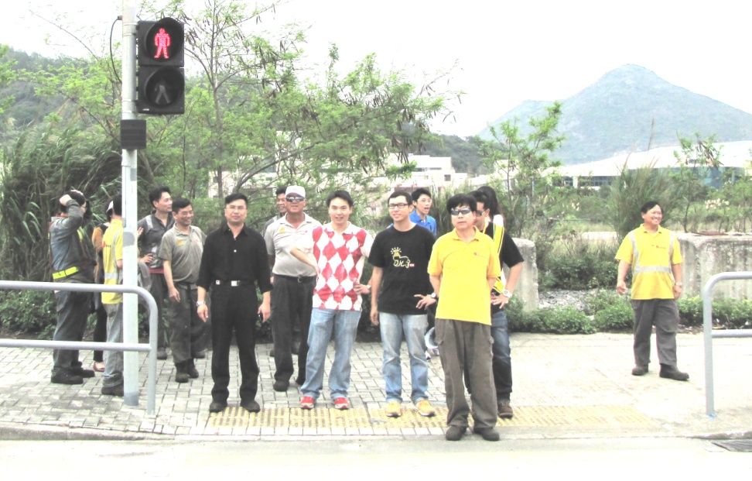
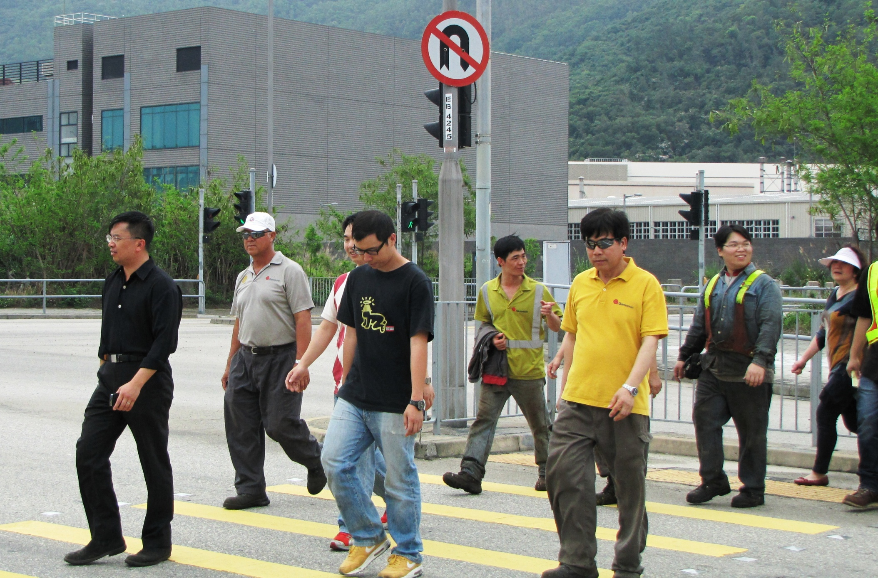
28 June 2011
Get Moving – On your Feet

Slide 6
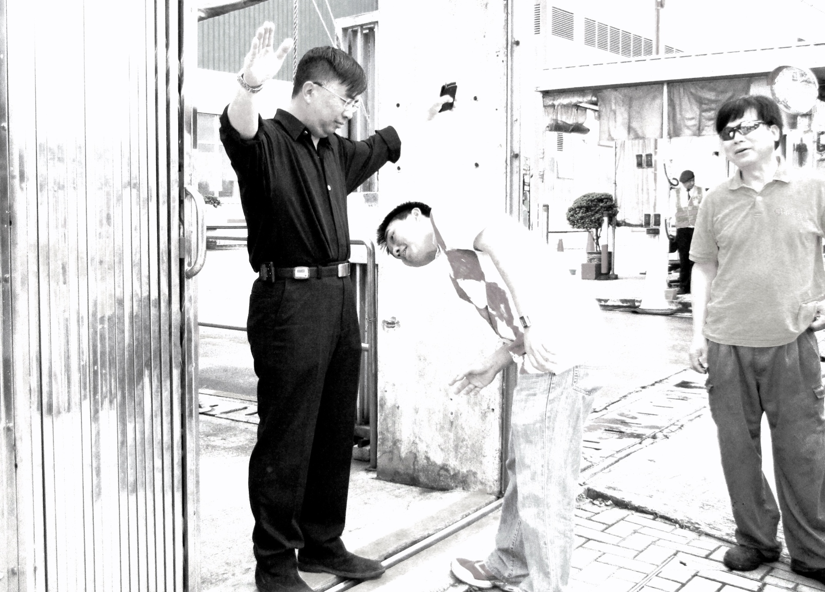
28 June 2011

Slide 7
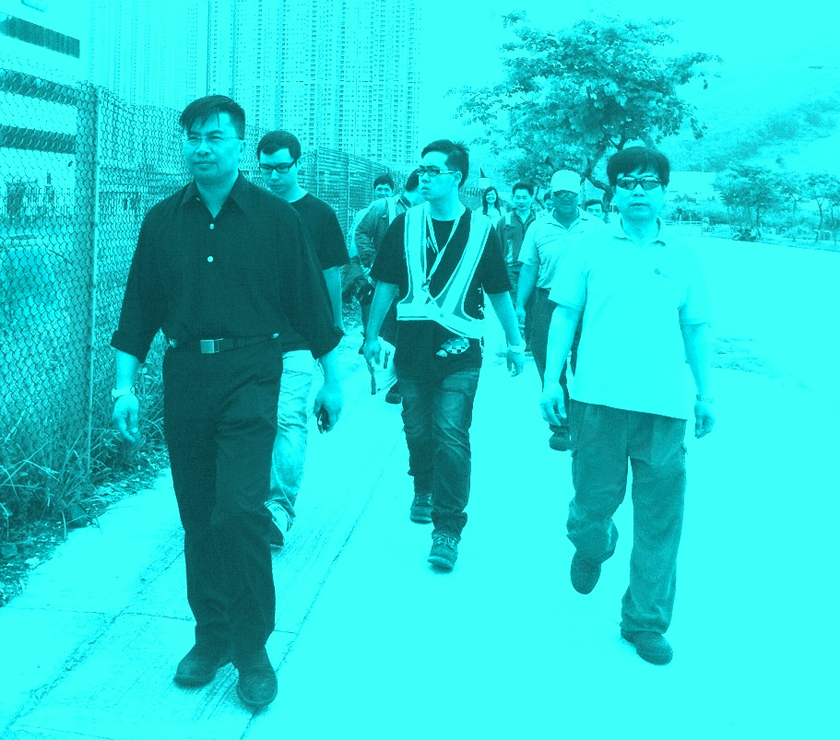
28 June 2011

Slide 8
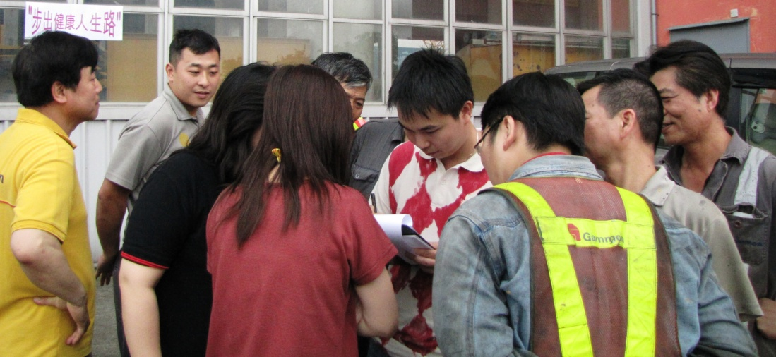
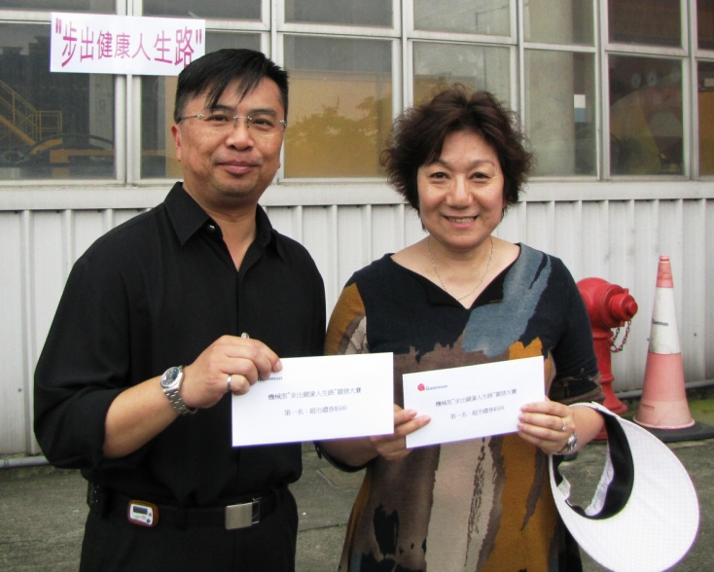
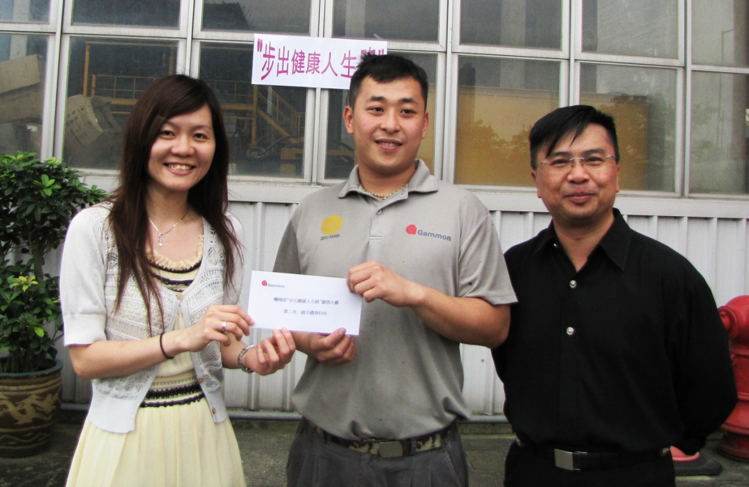
28 June 2011
Get Moving – On your Feet
圍 賽 果

Slide 9
"步出健康人生路"
比賽結果
唐維政先生：3521步
得獎名單
Gary Lee: 3540步 ($500, 相差19步)
Joe Har: 3500步 ($500, 相差21步)
李福鏗: 3555步 ($300, 相差34步)
Au Ka Wai: 3472步 ($300, 相差49步)
Wong Chi Wai: 3600 步 ($200, 相差79步)
李振剛: 3406步 ($200, 相差115步)
28 June 2011

Slide 10
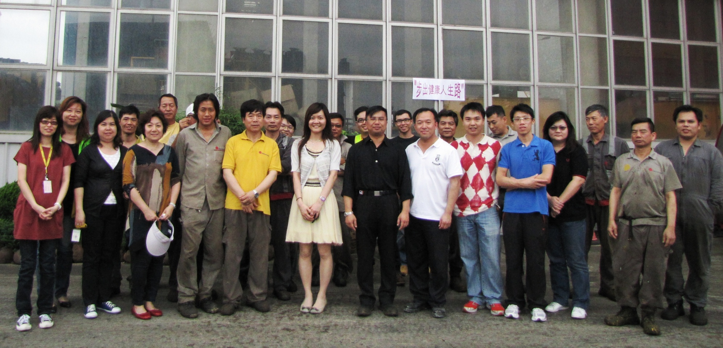
28 June 2011
待 續 ……

Slide 11
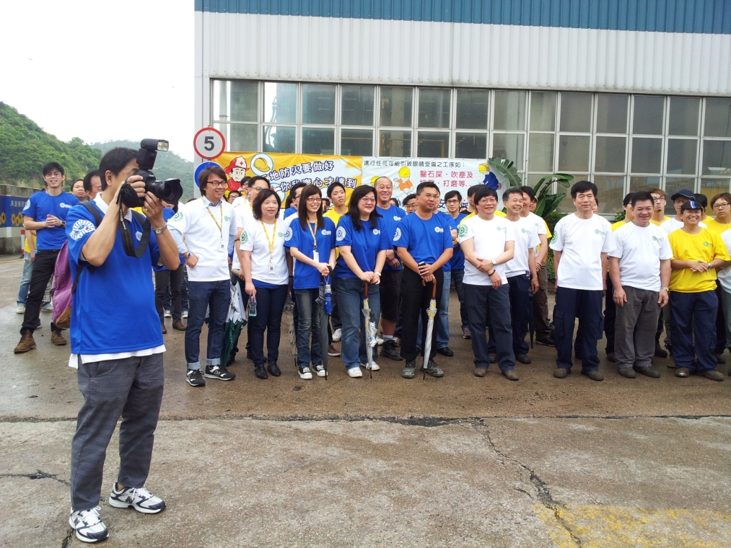
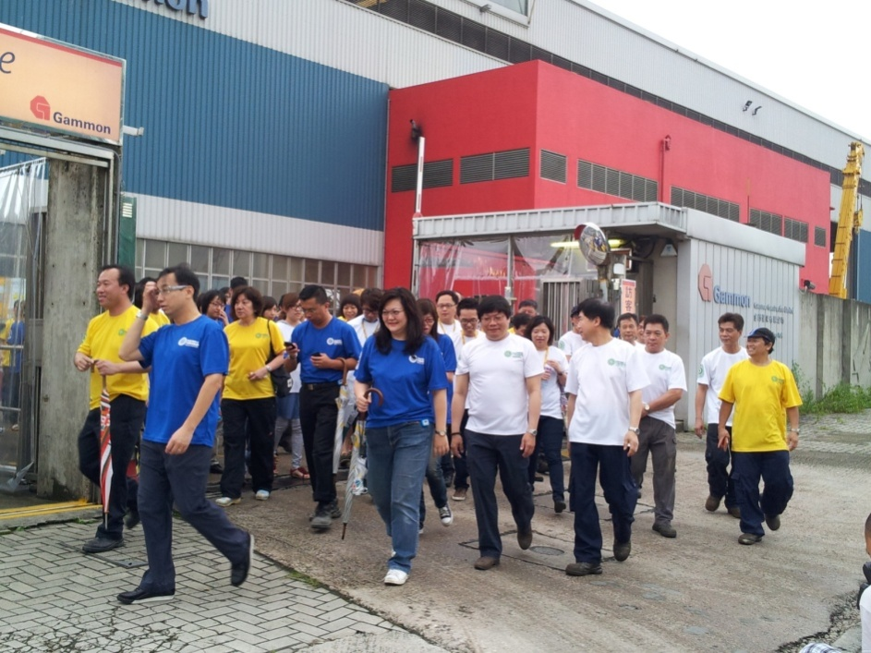
H&S Events (cont’d)
CSD
Sustainability Month, Step Count Challenge
15 May 2012
11 May 2012

Slide 12
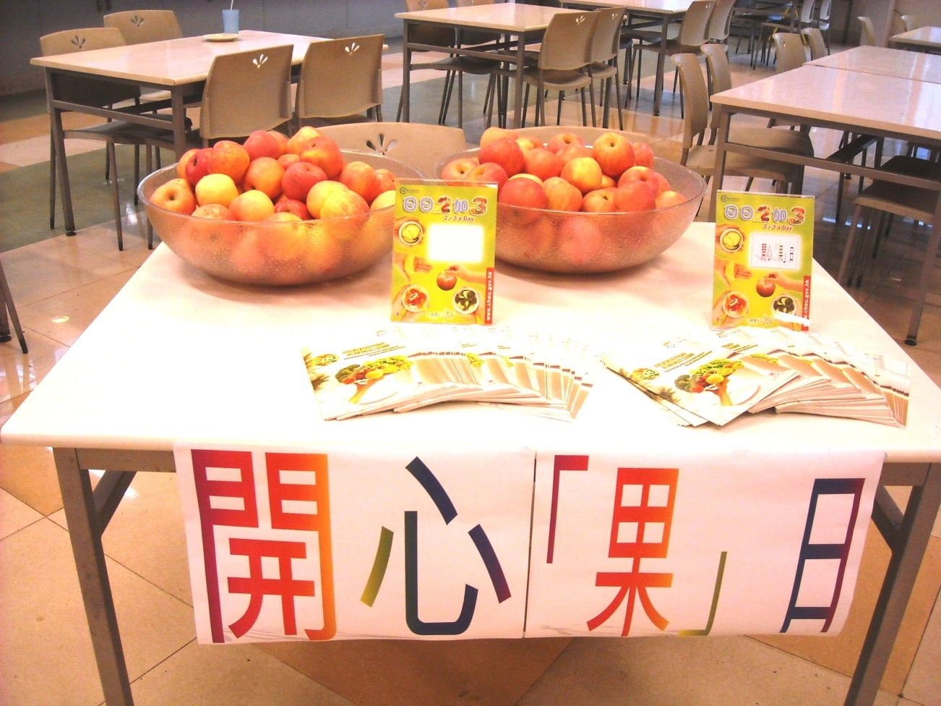
H&S Events
28 June 2011
Health@work.hk Pilot Project
Update
The 3rd activity was “Joyful Fruit Day” of the Healthy Eating Series.
The activity was held at the TKO canteen on 17 June 2011.

Slide 13
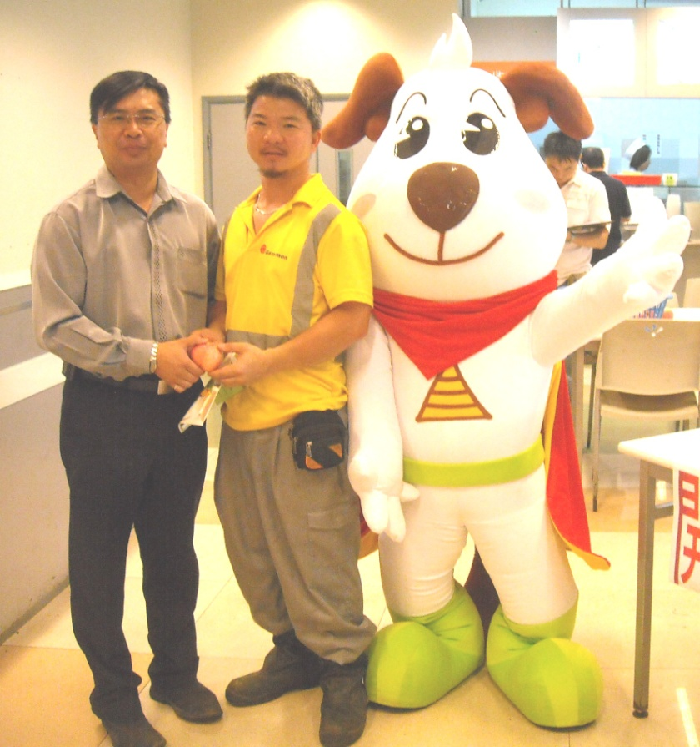
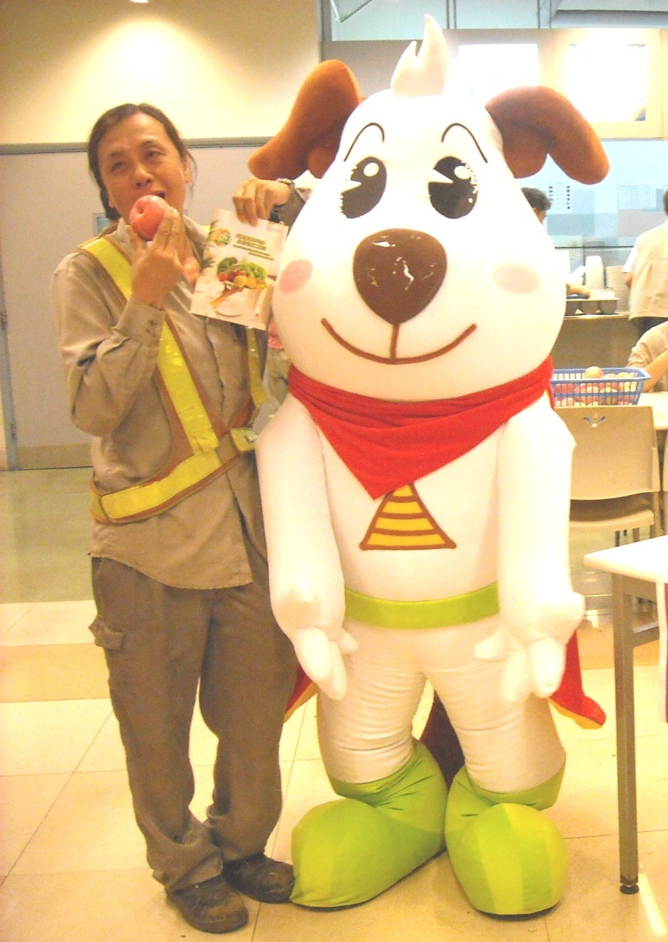
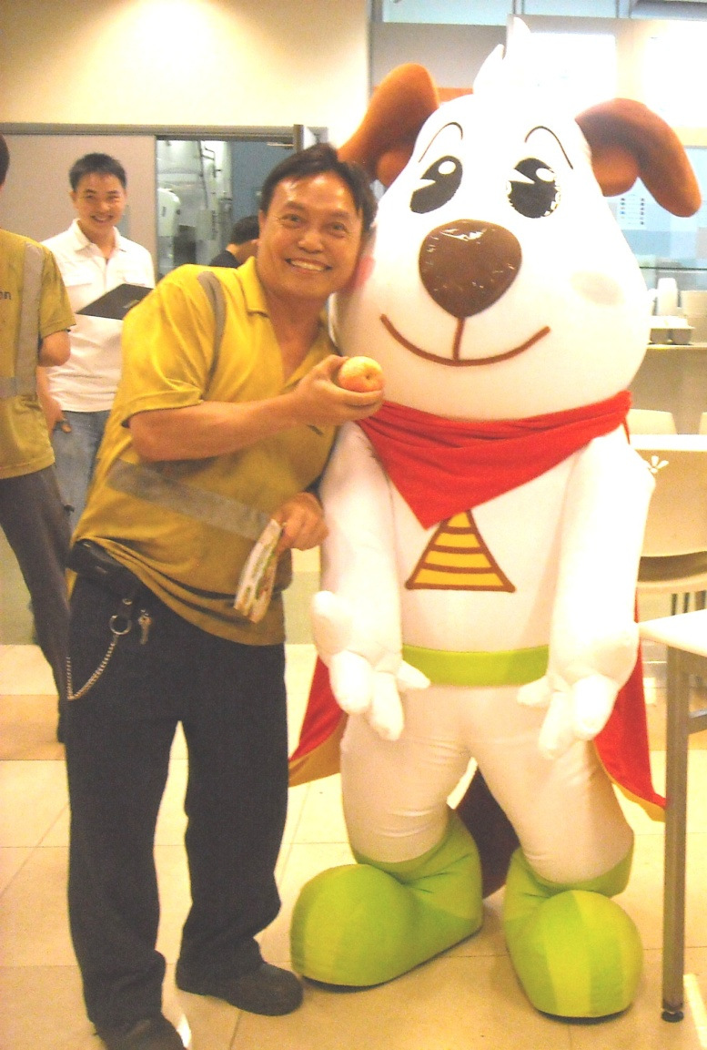
28 June 2011
Joyful Fruit Day

Slide 14
H&S Events
19 July 2011
Health@work.hk Pilot Project
Update
The 4th activity was “Stretching Exercise in the Workplace” of the Physical Activity Series.
The activity was held at the GTP Gammon Academy Training Room on 12 July 2011.
3 sessions were held on that day and 83 staff and workers joined the activity.

Slide 15
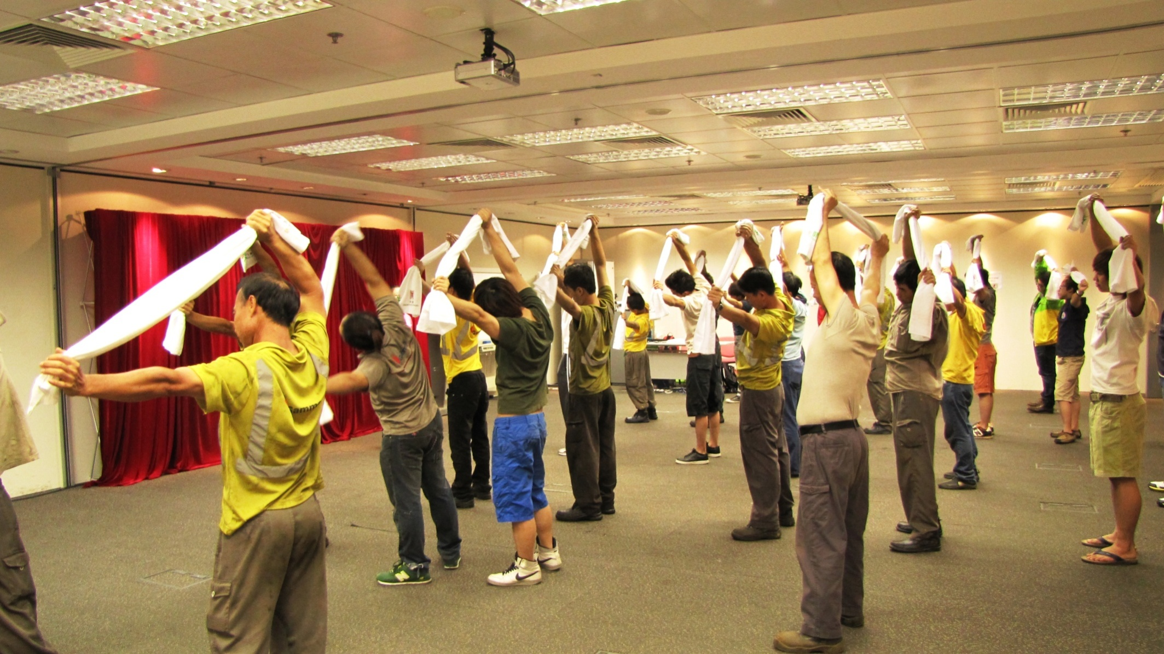
19 July 2011
Stretching Exercise

Slide 16
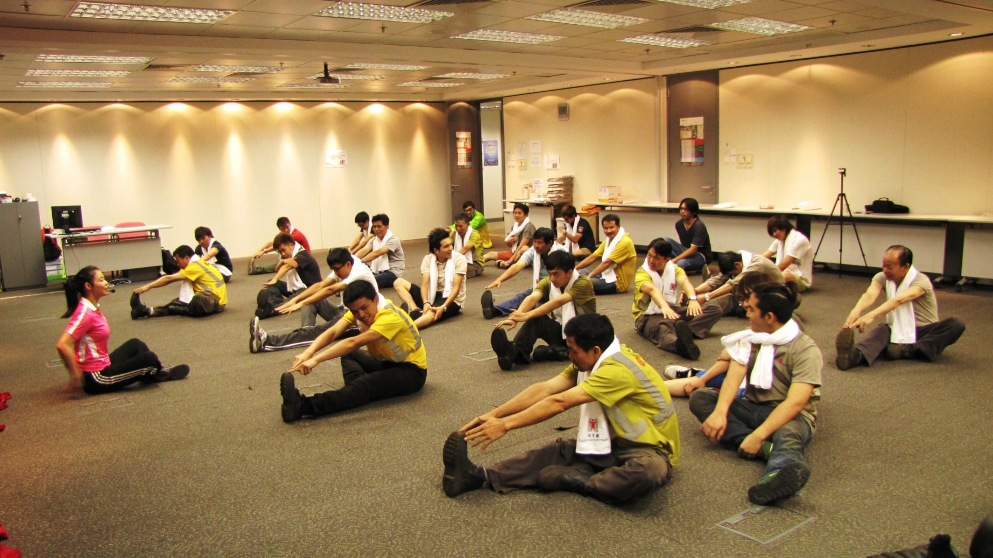
19 July 2011
Stretching Exercise

Slide 17
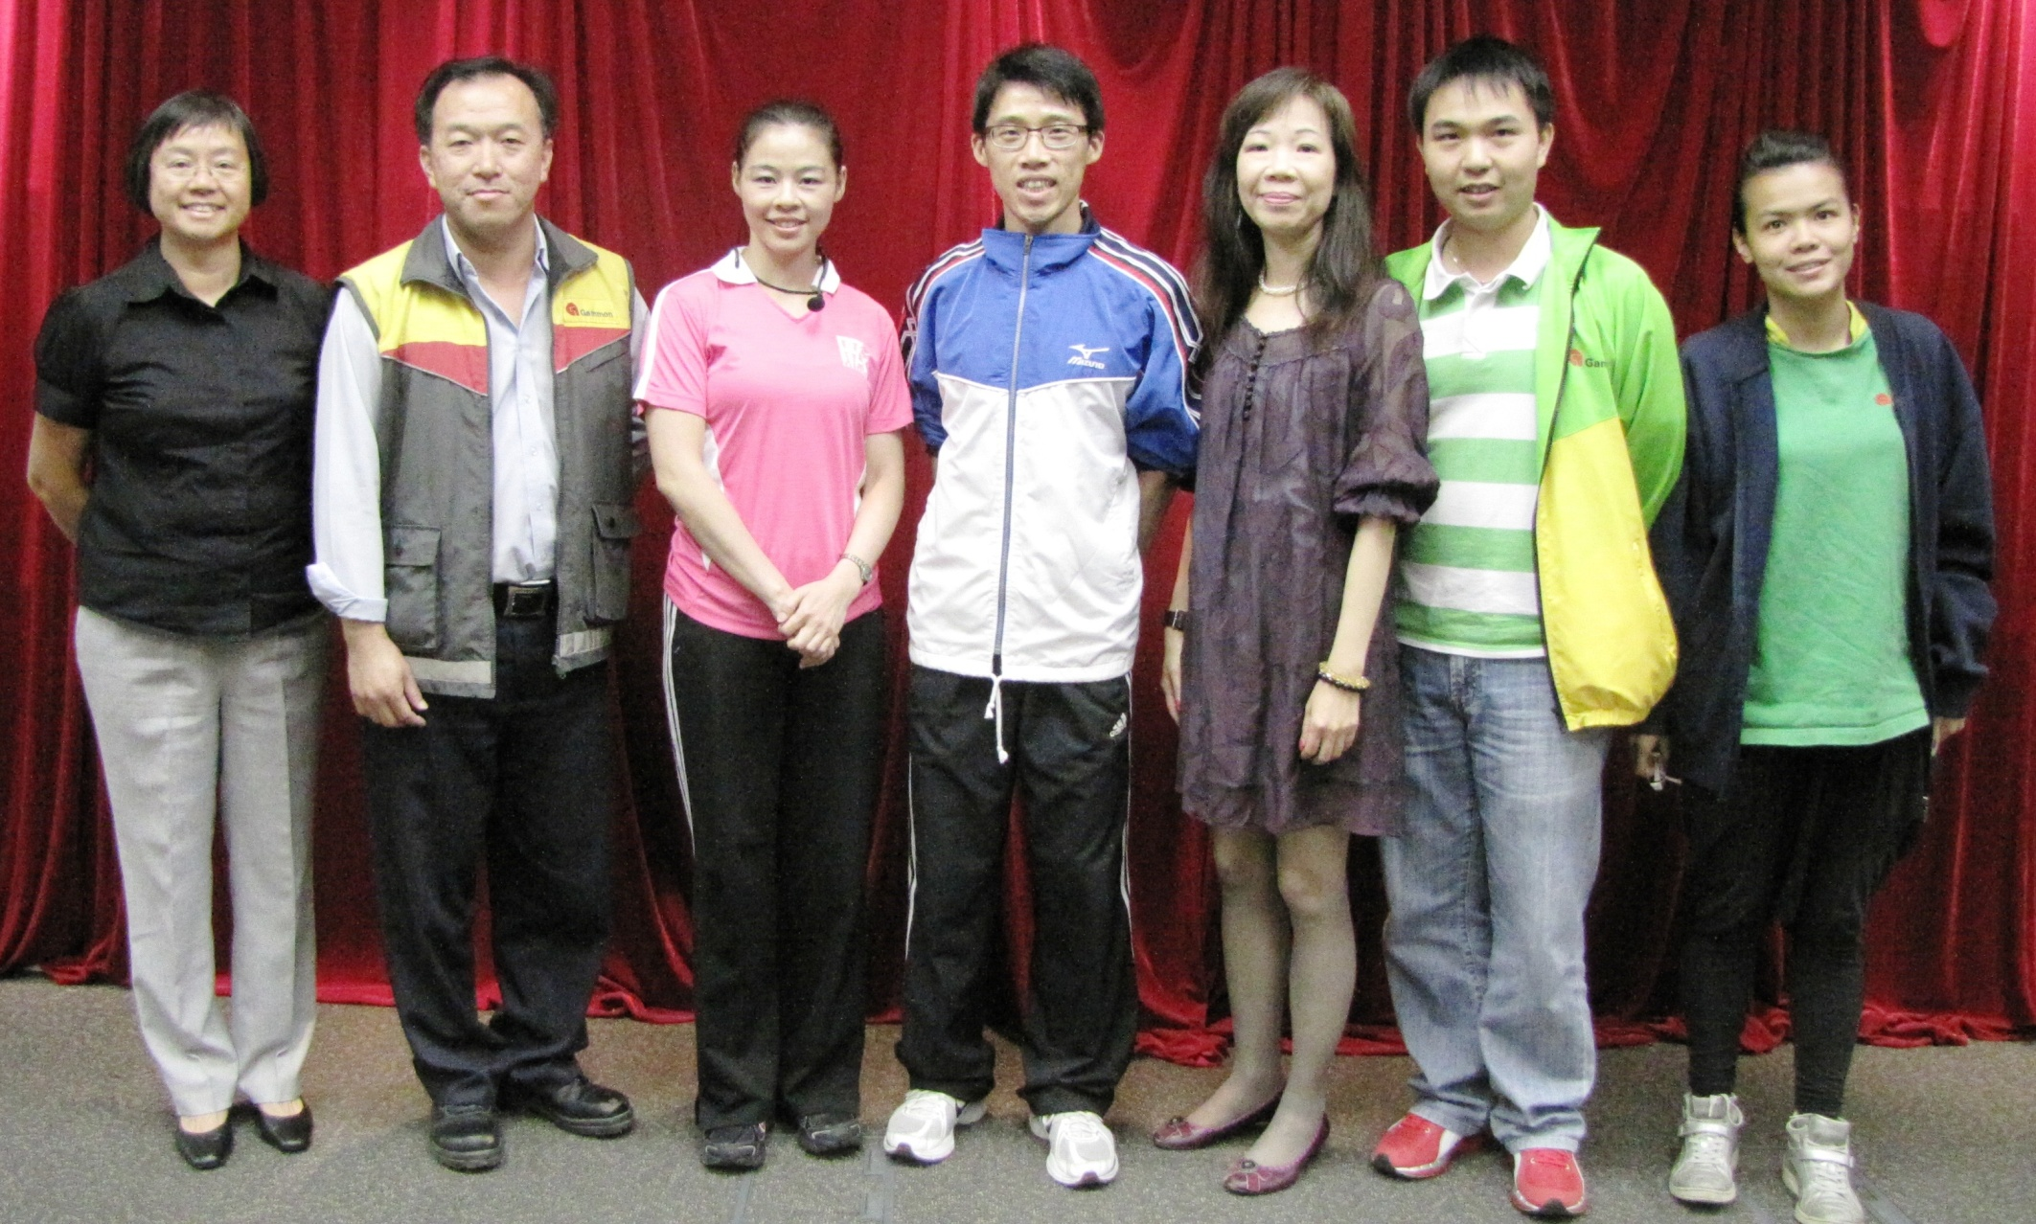
19 July 2011

Slide 18
H&S Events
24 August 2011
Health@work.hk Pilot Project
Update
The 5th activity was “EatSmart Tips for a Healthy Heart” of the Healthy Eating Series.
3 sessions of seminar were held at the GTP Gammon Academy Training Room on 9 August 2011.
104 staff and workers attended the seminars.

Slide 19
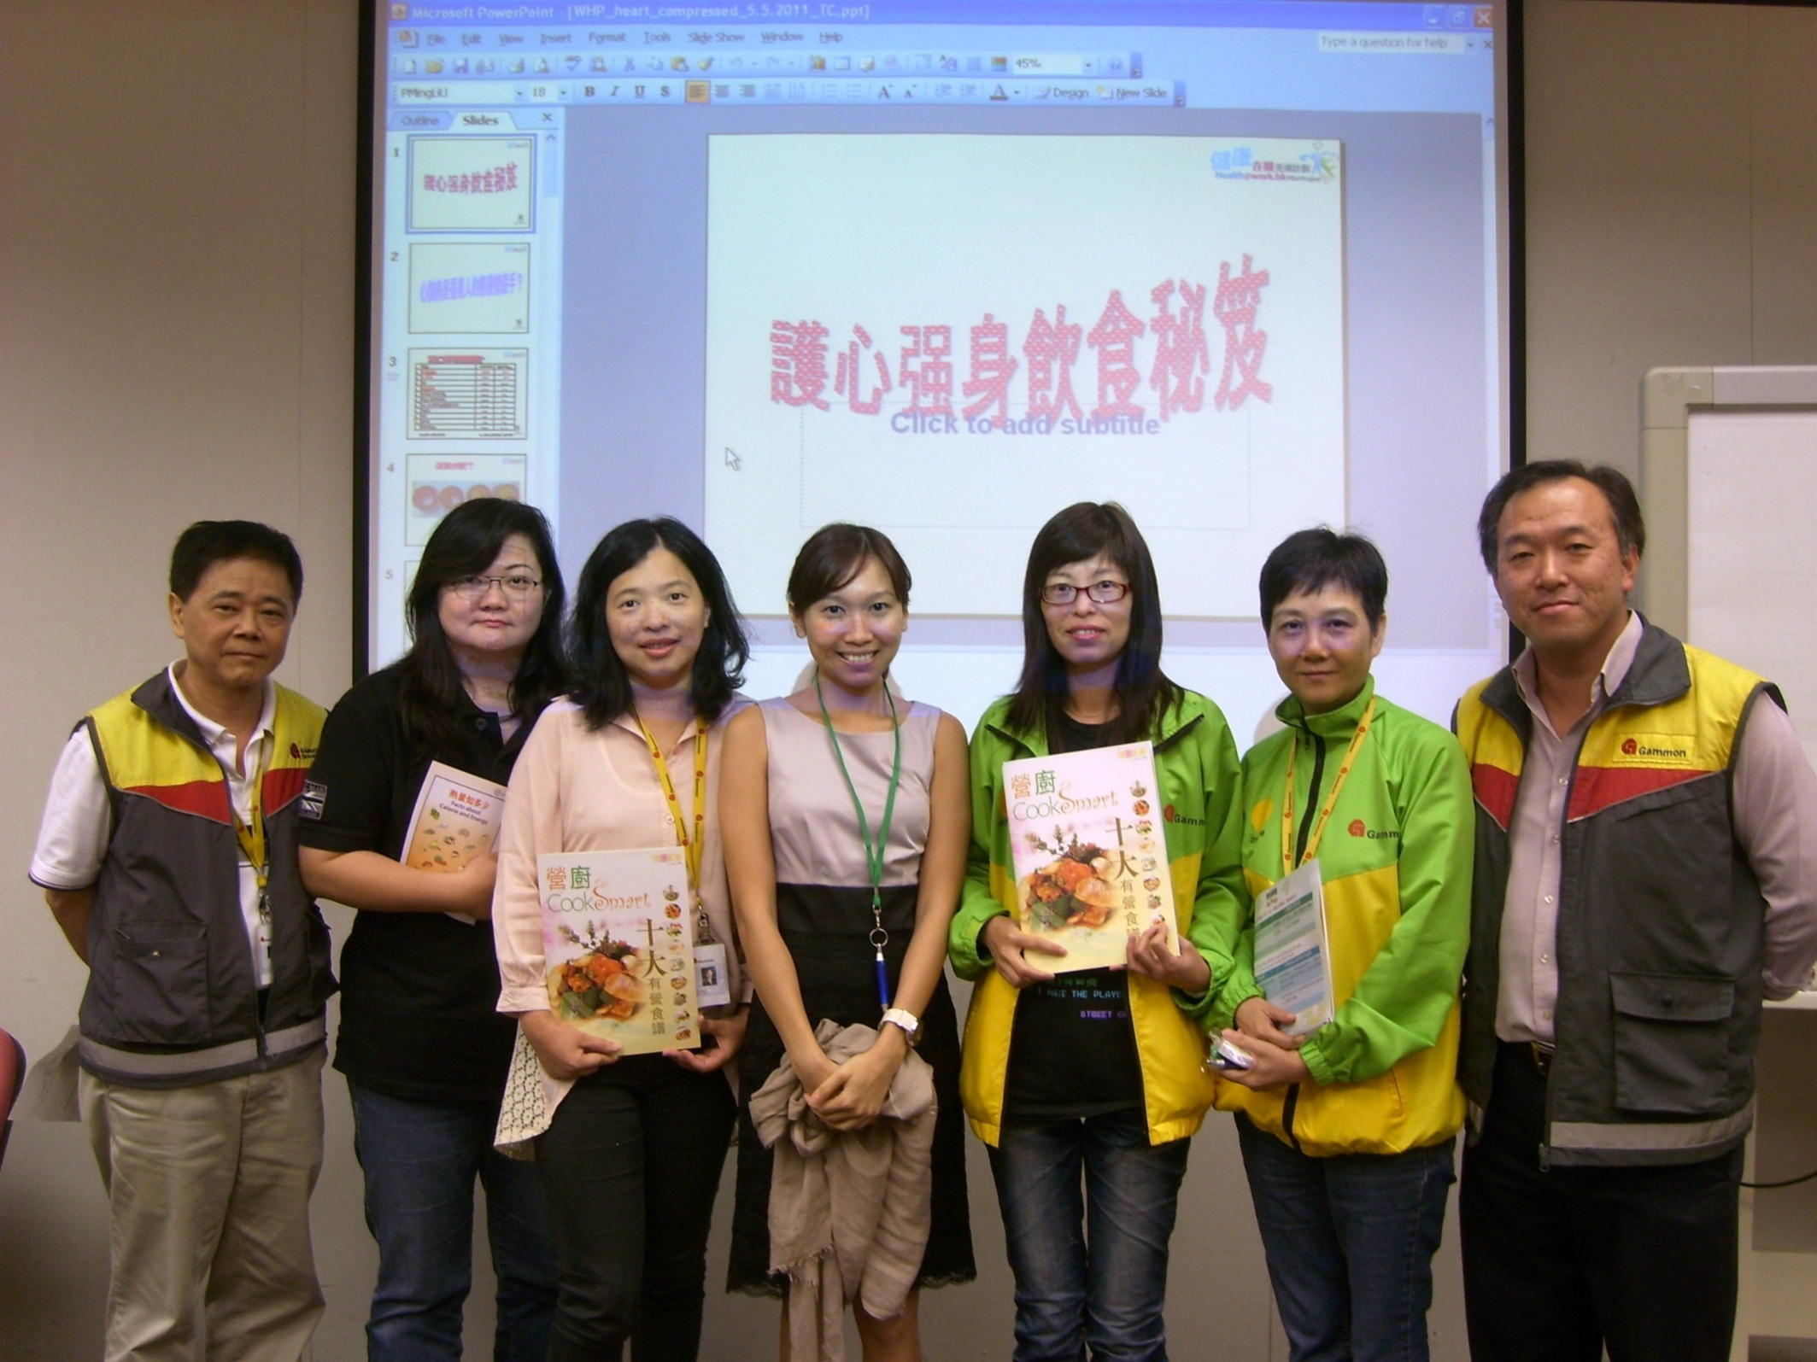
24 August 2011

Slide 20
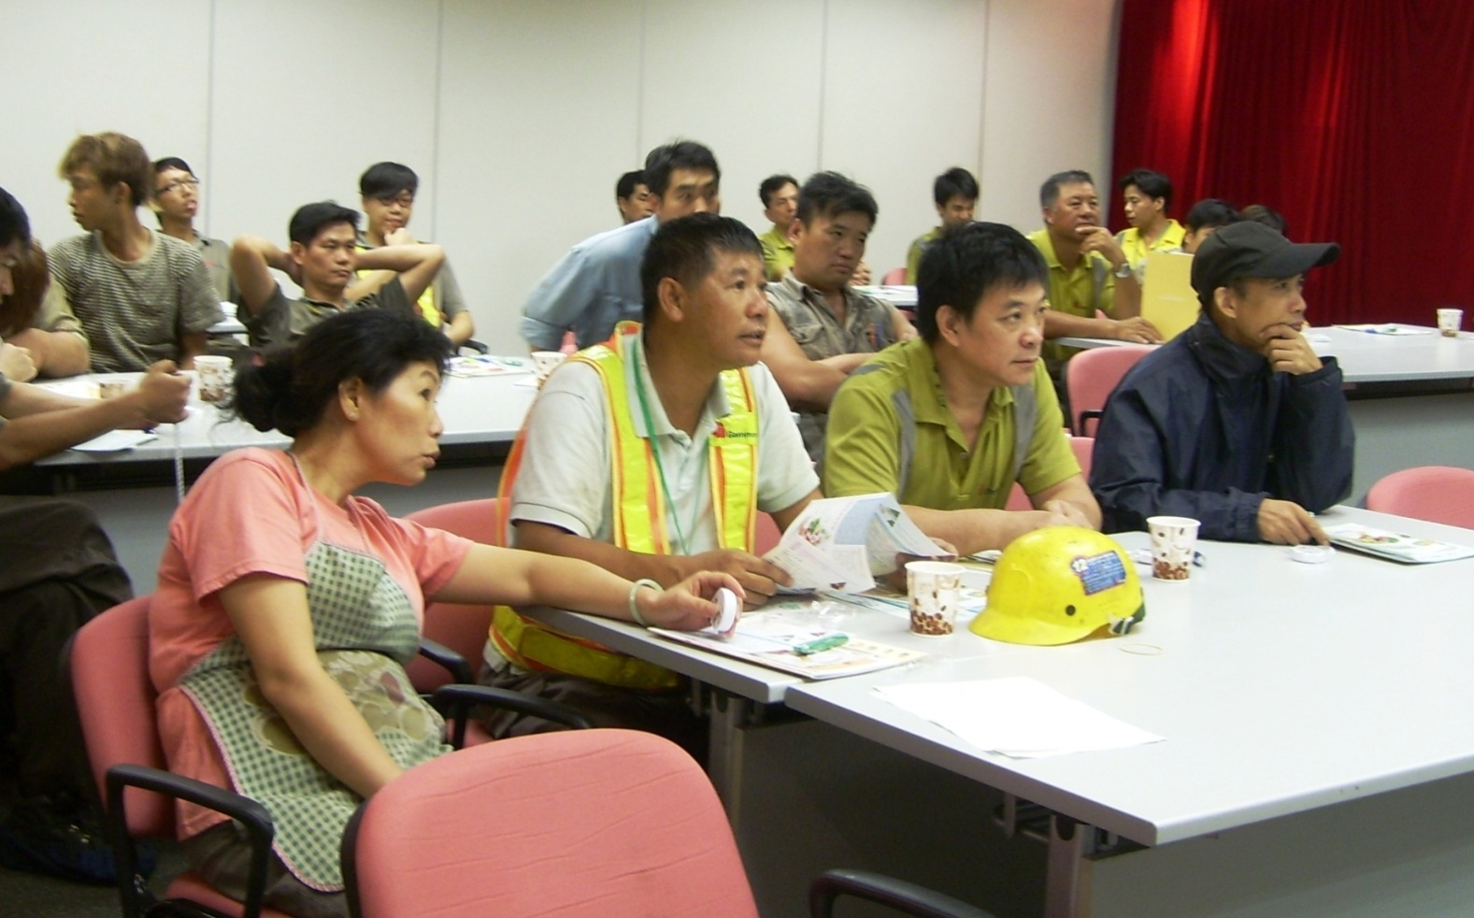
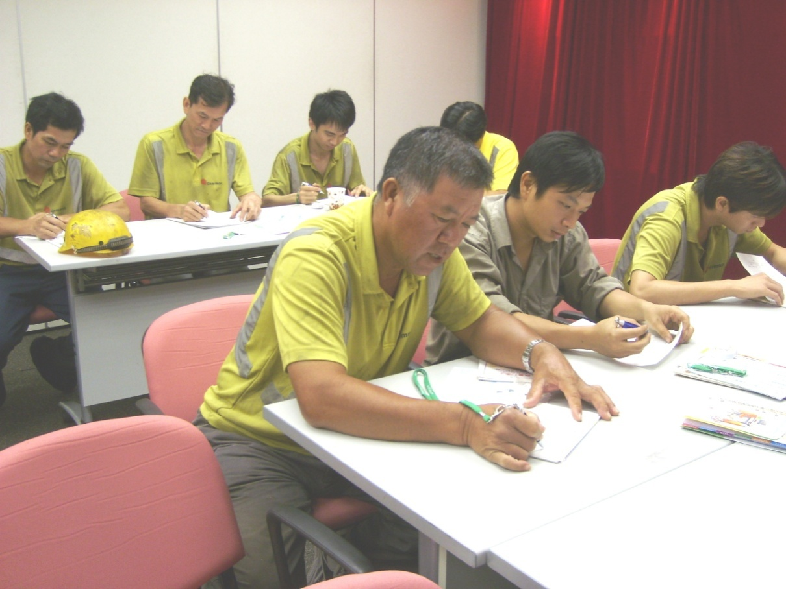
24 August 2011
專 注
EatSmart Tips for a Healthy Heart
認 真 作 答

Slide 21
H&S Events
19 September 2011
Health@work.hk Pilot Project
Update
The 6th activity was “Elastic Band Stretching Exercise” of the Physical Activity Series.
3 sessions of exercise were held at the GTP Gammon Academy Training Room on 6 September 2011.
74 staff and workers attended the exercise.

Slide 22
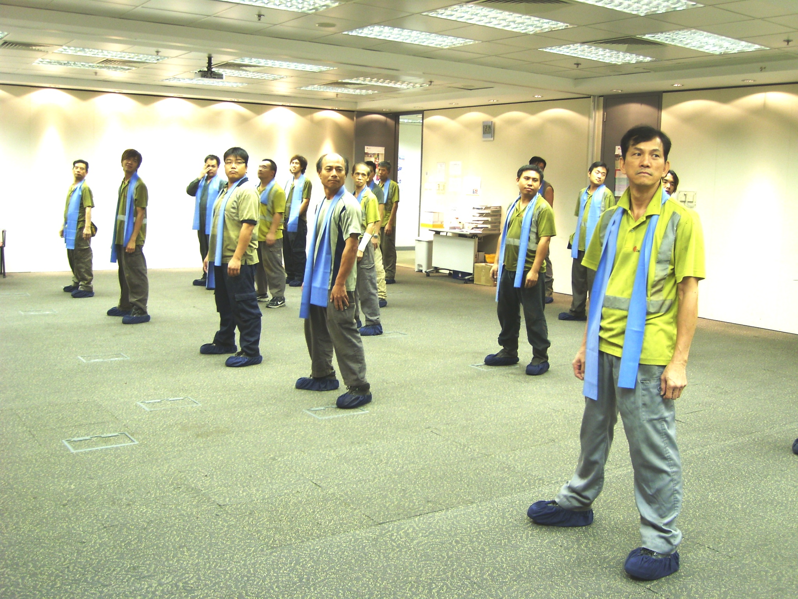
Elastic Band Stretching Exercise
19 September 2011

Slide 23
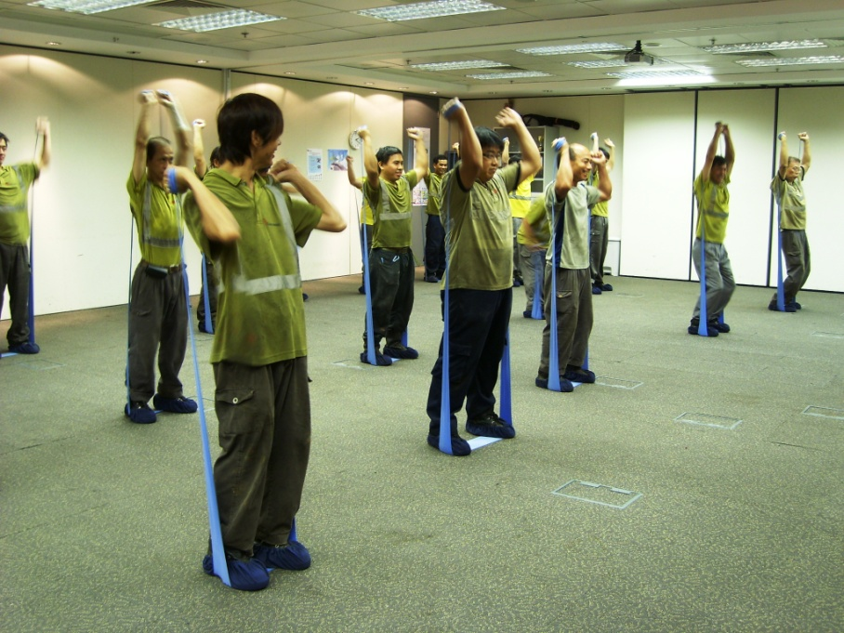
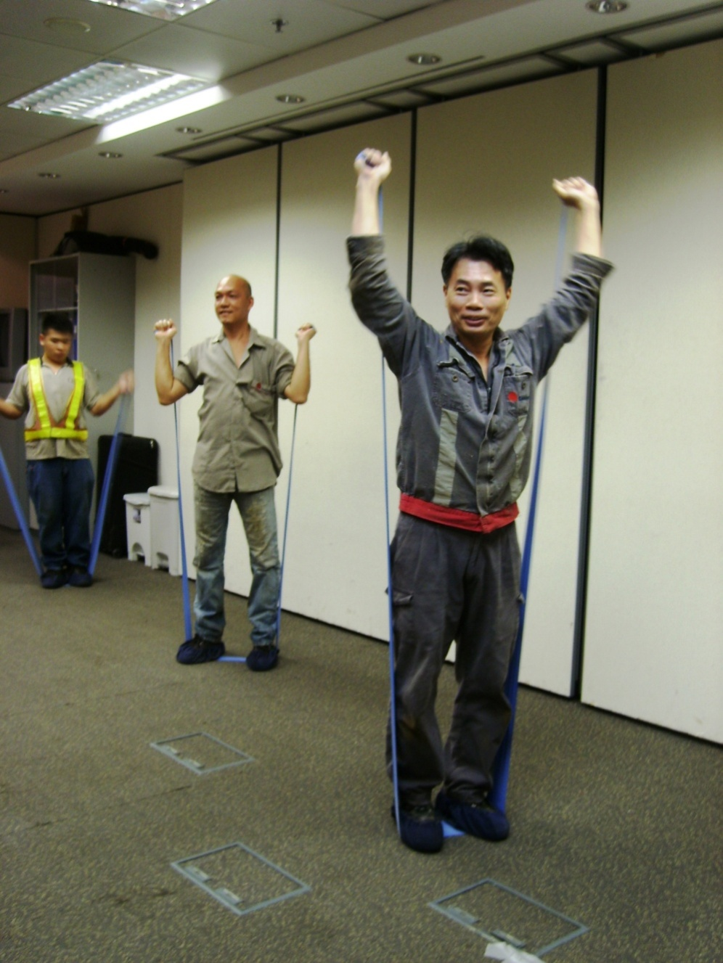
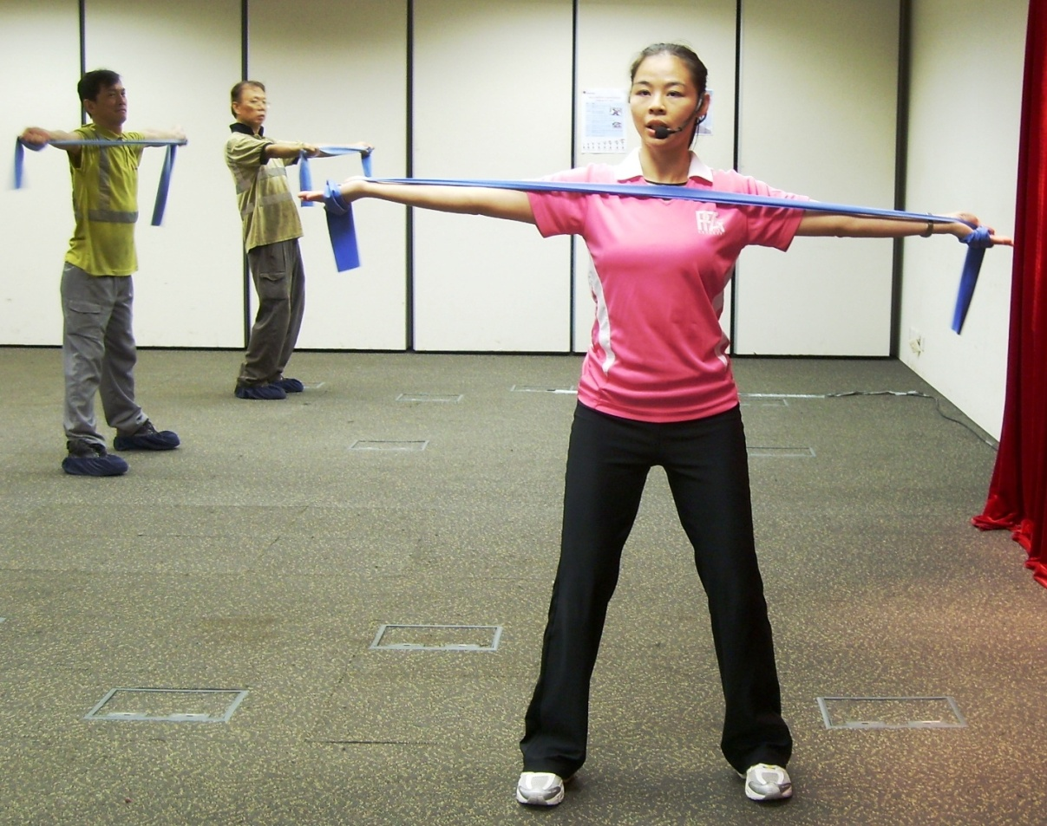
19 September 2011
kkkkkkiiiii

Slide 24
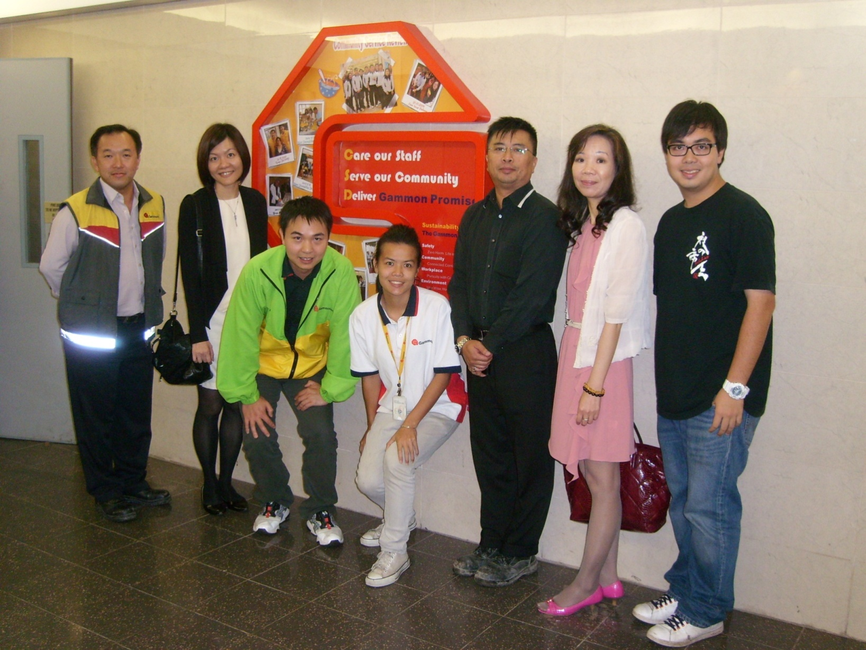
H&S Events
18 October 2011
Project Review Meeting (10 October 2011)

Slide 25
H&S Events
15 November 2011
Health@work.hk Pilot Project
Update
The 7th activity (last one) was “Read Nutrition Labels for Choice of Snacks” of the Healthy Eating Series.
3 sessions of talk were held at the GTP Gammon Academy Training Room on 25 October 2011.
69 staff and workers attended the talk.
This pilot project was totally completed on 25 October 2011.

Slide 26
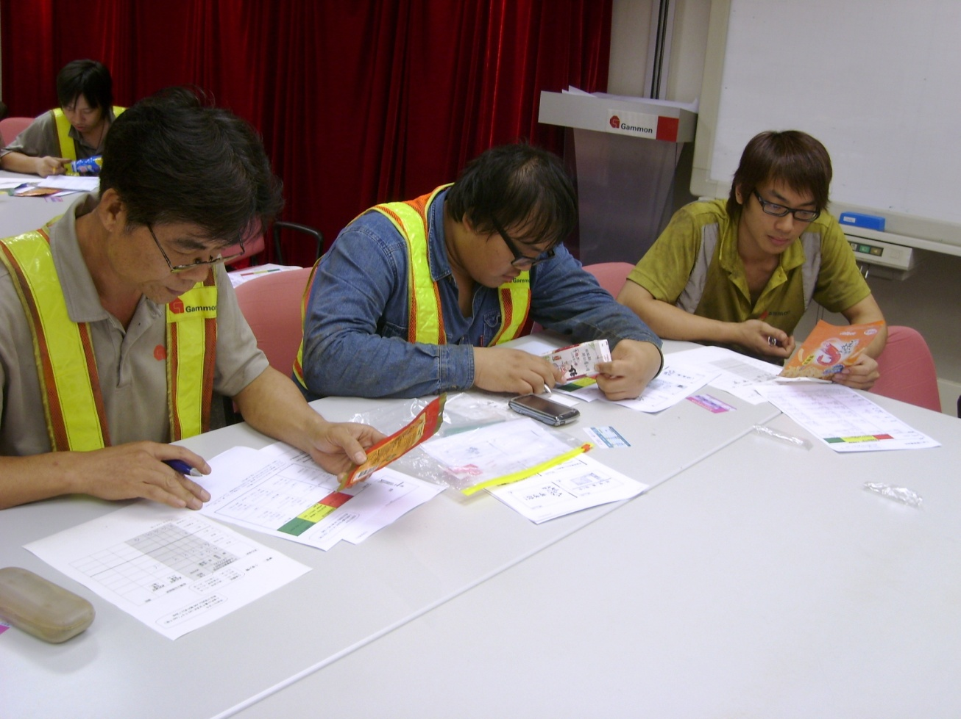
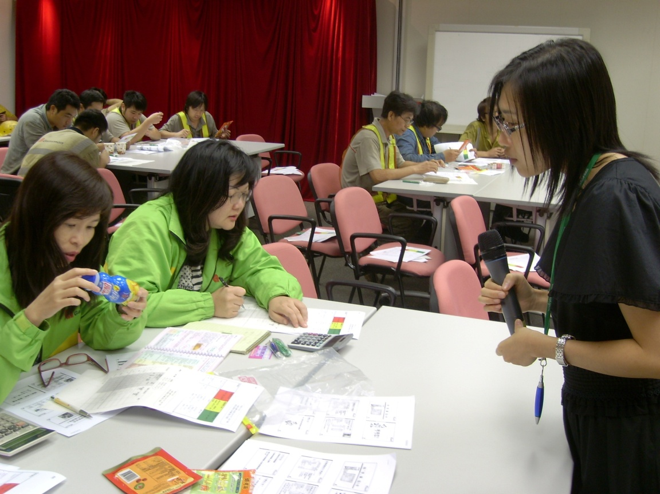
H&S Events
15 November 2011
More difficult than work
Come on
???
Why E=mc² ?
F=ma ?
Read Nutrition Labels for Choice of Snacks

Slide 27
Thank you

